Slide 1
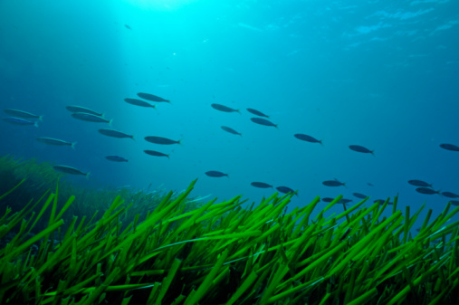
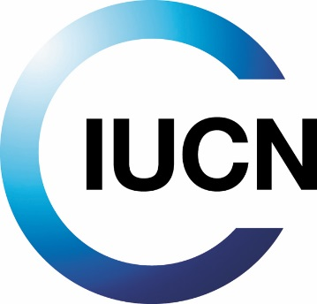
Experiences on implementation of ecosystem-based approaches to climate change mitigation
01 December 2015 – UNFCCC COP21 Paris, France
Dorothée Herr, GMPP, IUCN
Ecosystem-based approaches to climate change mitigation in oceans and coastal ecosystems

Slide 2
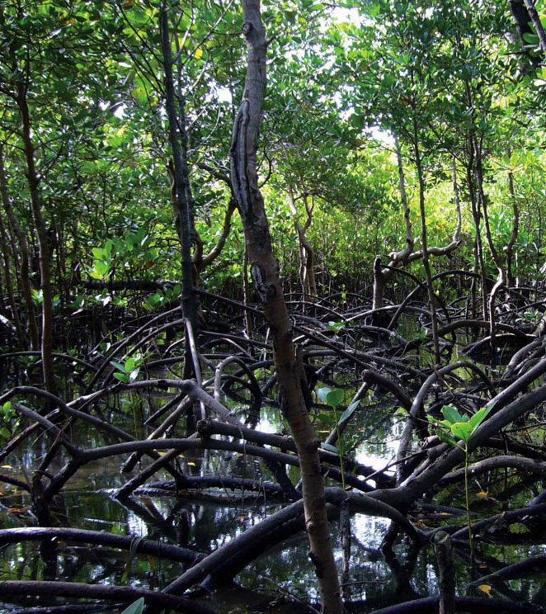
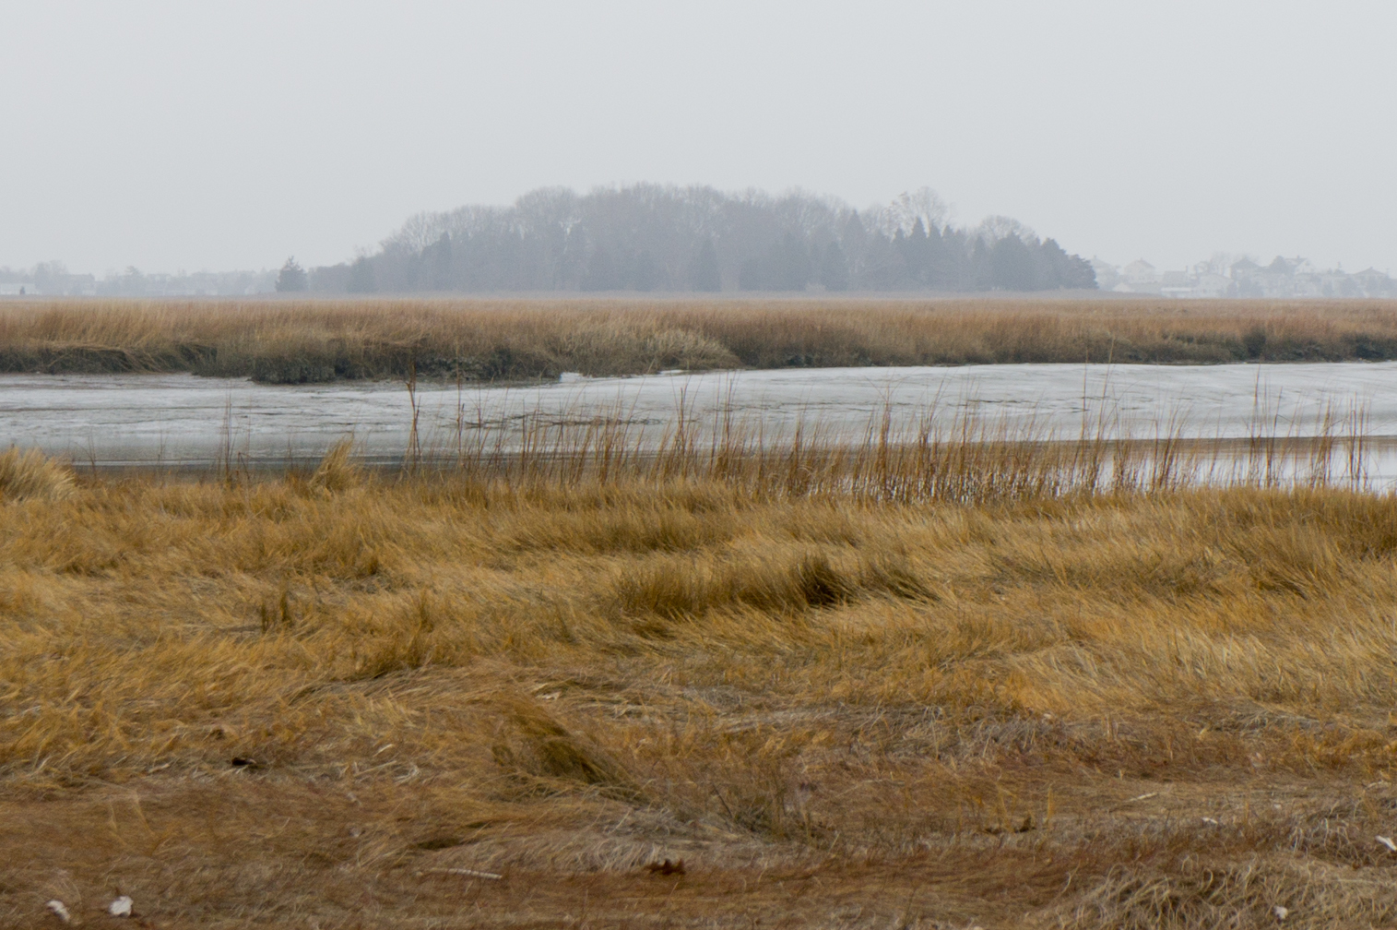
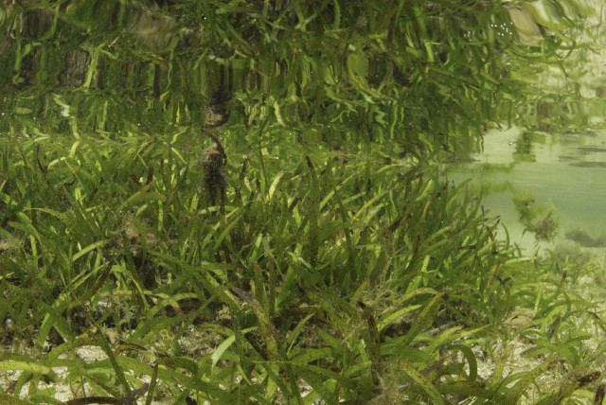
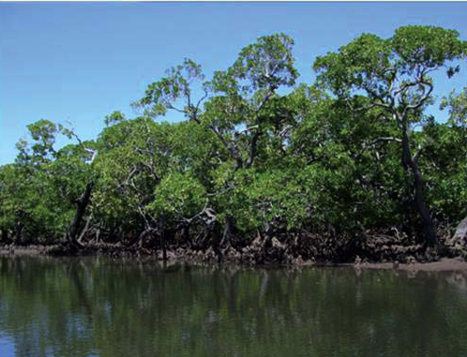
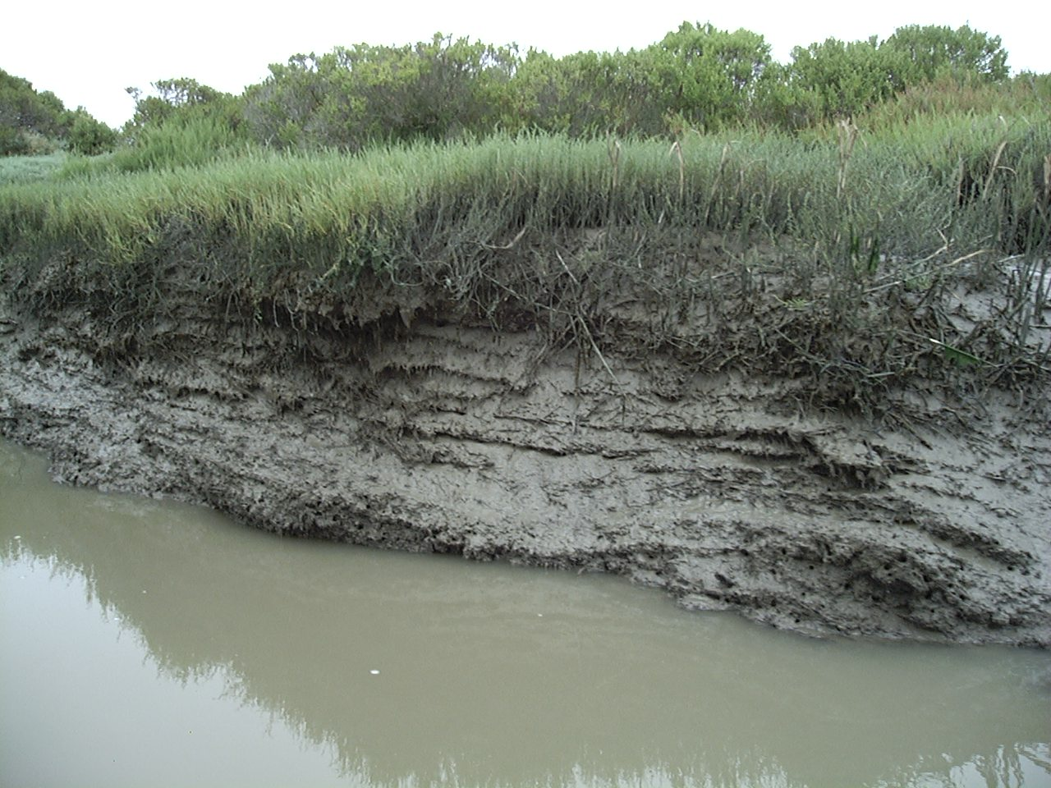
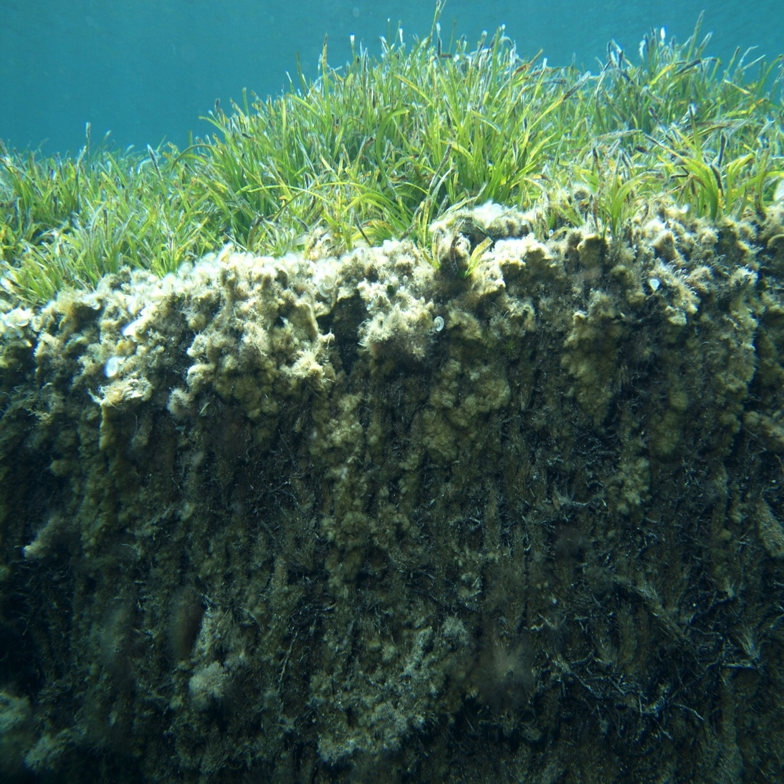
Coastal (carbon) wetlands
Photos clockwise from top left: © Steve Crooks, © CI/photo by Sarah Hoyt, © M.A. Mateo, © Keith Ellenbogen, © Jeff Yonover, © CI/photo by Sarah Hoyt
Notes:
Coastal Ecosystems – many critical ecosystem services
Fisheries
Coastal protection & erosion control
Coastal Water Quality
Livelihoods (tourism etc.)
Cultural value
Food
Biodiversity
Carbon sequestration and storage

Slide 3
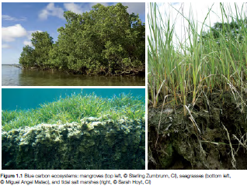
Coastal Blue Carbon under the UNFCCC - Overview
1992
2009
2005
2013
2015
INDCs
Technical and scientific aspects
IPCC Wetlands Supplement
Blue Carbon / Coastal marine ecosystems discussed as sinks and sources
REDD negotiations started - Reducing Emissions from Deforestation and forest Degradation
Aware of the role and importance in … marine and coastal ecosystems of sinks and reservoirs of GHGs
Notes:
1992
“Aware of the role and importance in terrestrial and marine ecosystems of sinks and reservoirs of greenhouse gases” – PREAMBULA
“Promote sustainable management, and promote and cooperate in the conservation and enhancement, as appropriate, of sinks and reservoirs of all 11 greenhouse gases not controlled by the Montreal Protocol, including biomass, forests and oceans as well as other terrestrial, coastal and marine ecosystems” – ART 4.1(d)
“Cooperate in preparing for adaptation to the impacts of climate change; develop and elaborate appropriate and integrated plans for coastal zone management, water resources and agriculture, and for the protection and rehabilitation of areas, particularly in Africa, affected by drought and desertification, as well as floods; ART 4.1(e)
2013
SBSTA 39 “to consider information on the technical and scientific aspects of ecosystems with high-carbon reservoirs not covered by other agenda items under the Convention, such as coastal marine ecosystems, in the context of wider mitigation and adaptation efforts”.

Slide 4
Overview of Incentives & Mechanisms for Coastal Blue Carbon
“Reporting” incentives
Supporting/achieving a better national GHG balance
Better managed wetlands = less emissions to report
National GHG reports
INDCs
Land Use, Land Use Change and Forestry Sector (LULUCF), incl. REDD
“Mechanism” incentives
Using mitigation mechanisms to develop national programs and attract funding
REDD+
NAMAs
Market incentives
Using the regulatory carbon market
CDM
REDD+ (?)
Notes:
Of course some caveats with this.
E.g. no mandatory reporting for wetlands

Slide 5
Overview for Coastal Blue Carbon
 | Non Annex I countries | Annex I countries
National Communication and reports to UNFCCC | Encouraged to include wetands in reporting | KP Parties can elect rewetting and drainage as LULUCF activity
& new IPCC wetlands guidelines | Encouraged to use | Mandatory to use (if they chose to elected wetlands as reporting category - KP)
CDM – mangroves only | As project implementers | Can be used to support mangrove reforestation activities in developing countries
REDD+ | Mangroves National implementation & sub national implementation | N/A
NAMAs | Opportunity for salt marshes, sea grasses, and non-forest mangroves | N/A
INDCs | LULUCF
Incentives to use CDM

Slide 6
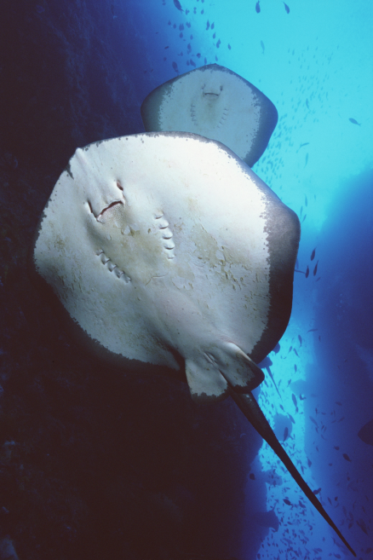
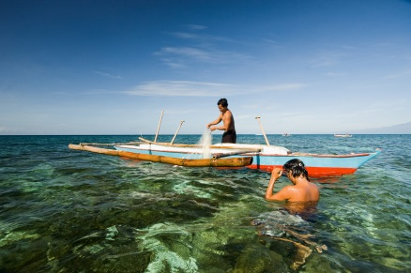
What Next?
Overall favourable UNFCCC environment
with „room for improvement“
„Fate“ of wetlands linked to broader LULUCF discussion and overall ambition of Paris agreement & INDCs
Much to do on national implemenation
  Technical support
  Financial support
  Policy development and planning, linking climate change (adaptation and mitigation) with coastal policies and planning (fisheries, biodiversity, conservation, etc)

Slide 7
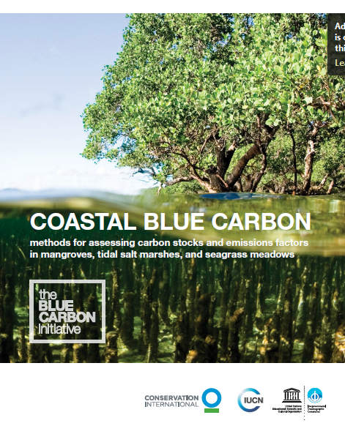
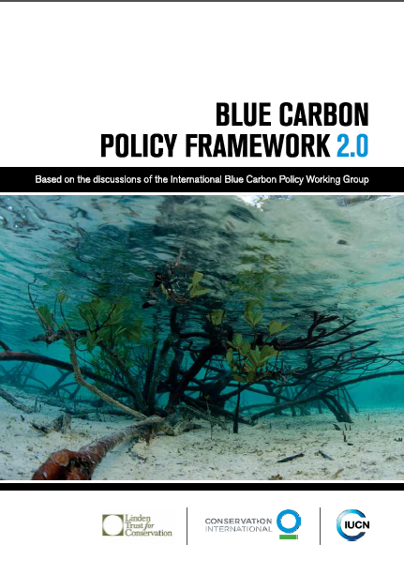
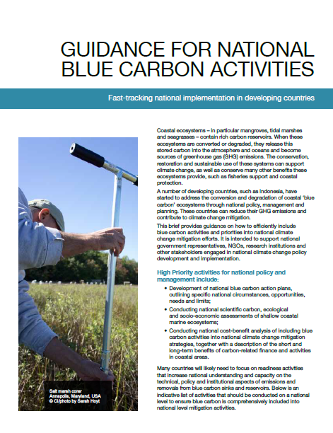
Active since 2009
Policy and scientific advise
Upcoming workshops 2016
Negotiations and national implementation

Slide 8
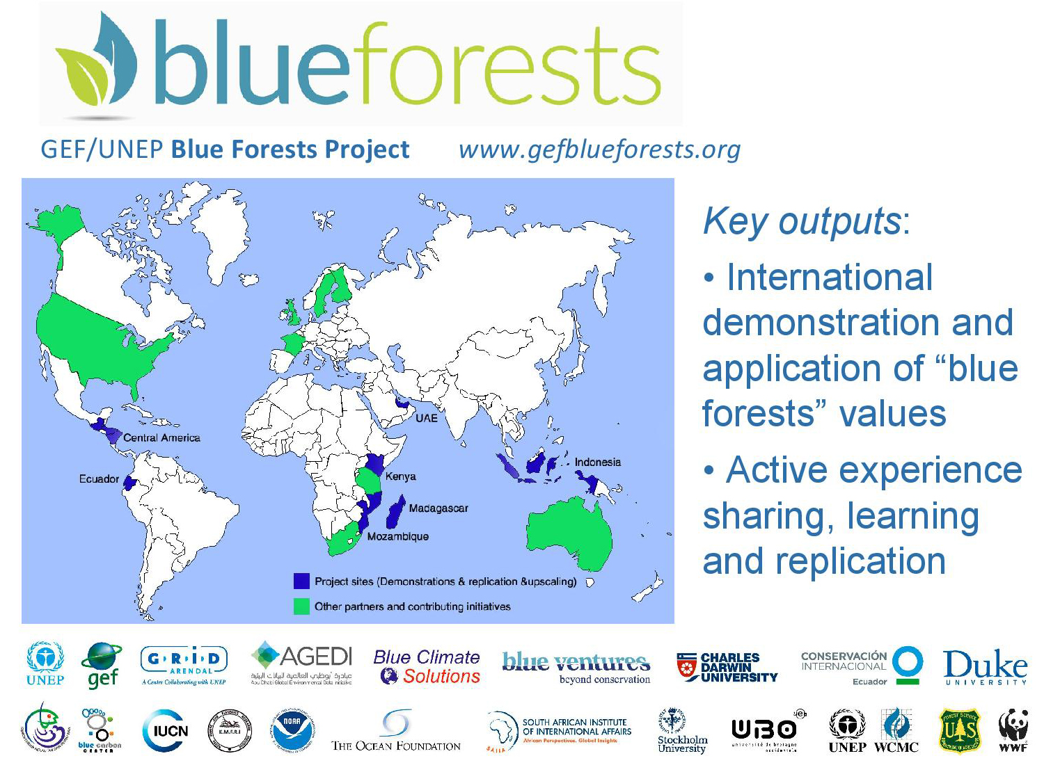
Notes:
8
8

Slide 9
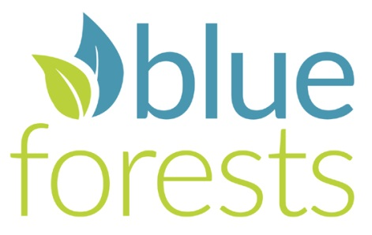
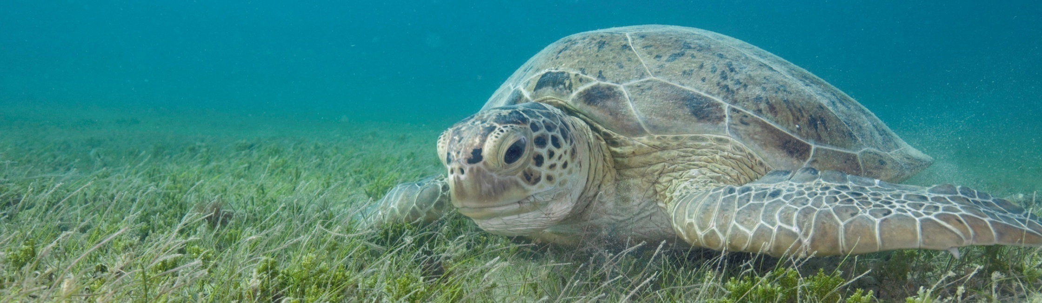
National policy assessments
Support capacity building
Upscaling and replication
Goal … to trace the policy, legal, and regulatory context for blue carbon ecosystems in five countries
Ecuador, Mozambique, Madagascar, Indonesia & UAE
… to extrapolate common trends, best practices and opportunities for climate-change-based protection and restoration policies

Slide 10
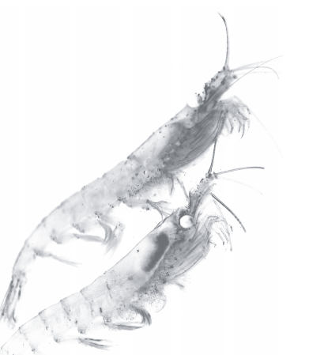
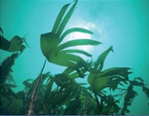
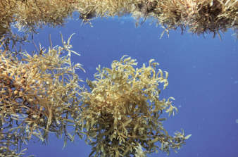
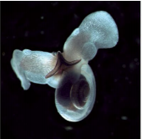
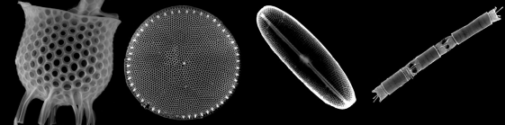
Ocean Blue Carbon and The UNFCCC
Marine ecosystems and species, incl. in the open ocean or deep sea (i.e., corals, kelp, plankton and marine fauna)
Important role in the carbon cycle – only a healthy ocean can maintain its climate services
?? Long-term storage
?? National carbon balances
As part of the UNFCCC / incentive mechanism??
We need a thoughtful debate
Laffoley, D., Baxter, J. M., Thevenon, F. and Oliver, J. (editors). 2014. The Significance and Management of Natural Carbon Stores in the Open Ocean. Full report. Gland, Switzerland: IUCN. 124 pp
Notes:
Pteropods
Open algal ecosystems: Diatoms
Seaweed

Slide 11
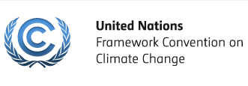













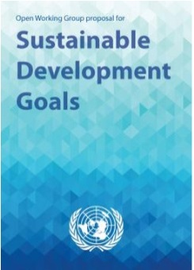
Keeping the Ocean healty and Functionable
Climate
Change
Oceans
Biodiversity
Conservation
A multitude of
Sustainable
Development
Global Policies
Sectoral Policies
Regional Policies

Slide 12
Experiences on implementation of ecosystem-based approaches to climate change mitigation
01 December 2015 – UNFCCC COP21 Paris, France
Dorothée Herr, GMPP, IUCN
THANK YOU!

